Slide 1
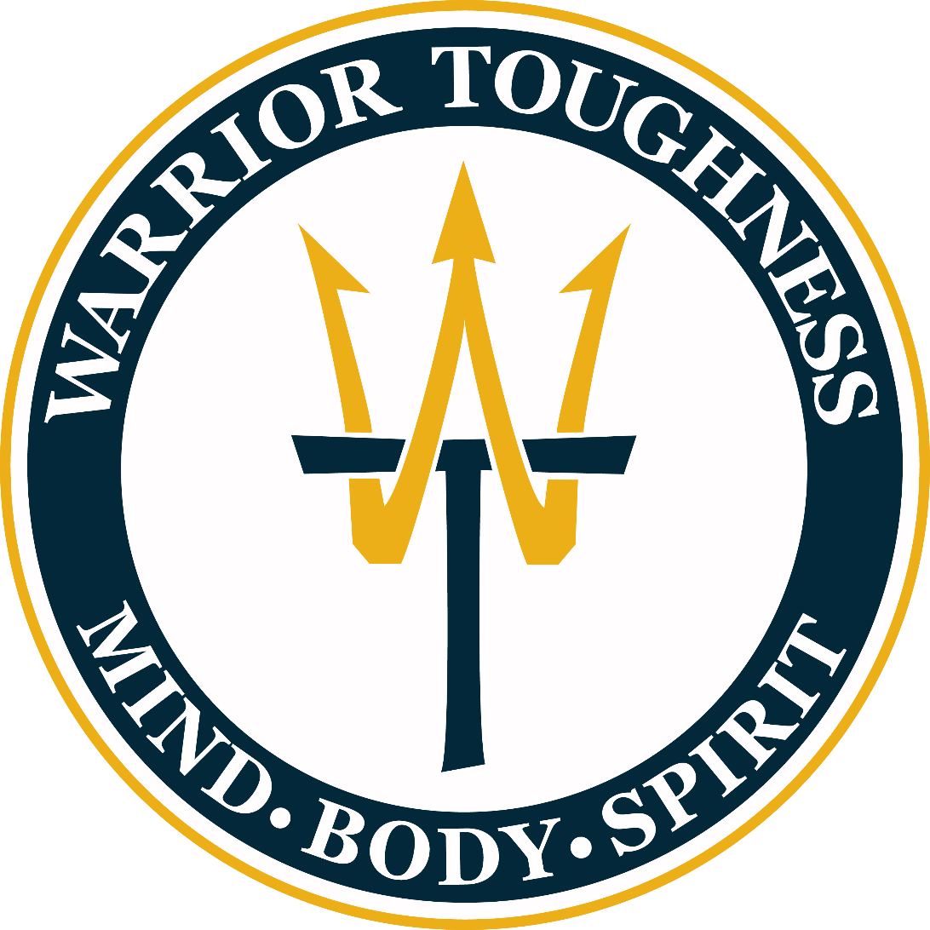
Welcome
Notes:
Topic: Healthy Behaviors
Time: 30 minutes
Purpose of training evolution: Sailors will strengthen their Warrior Toughness by identifying healthy behaviors to increase their readiness for peak performance.
Expected outcome of training evolution: Sailors will be able to engage in healthy behaviors to maximize their performance.
Safety: Inform Sailors of safety hazards in the training environment. For some topics, Sailors should be informed if there is a designated person to talk to if the Sailor feels compelled to leave the training.
Facilitator Actions:
Display slide.
Greet Sailors.
Introduce yourself and give any background on yourself that might be of interest.
Establish credibility.
Facilitator Instructions:
The slide deck acts as a guide to present a facilitated discussion that may include activities.
Best practice: Use the slide to develop interest in the subject matter. Do not read the slides word for word. The Sailors should be able read the text and understand the messaging presented in the graphics.
Facilitator notes are available for each slide to help the Facilitator deliver the topic.
Best practice: Use the Slide Show view to ensure the Facilitator notes are viewable.
The Facilitator notes are divided into general instructions for Facilitator Actions (mechanics of facilitation) and the Facilitator Content (Inform, Discuss, Perform, and Reference).
Best practice for Inform: Present facts, concepts, and procedures. Depending on the facilitator’s expertise, content may be used as background information or suggested talking points. Content in quotation marks is recommended to be read verbatim.
Best practice for Discuss: Conduct large-group question and answer sessions or large-group, Facilitator-led activities. Depending on the subject matter, these may be written as questions with expected answers or scripted activities.
Best practice for Perform: Facilitate small-group, scenario-based or procedural activities. Depending on the subject matter, these may be written with specific actions the Sailors will take or general ways for the Facilitator to monitor the activities. The Facilitator will be provided with expected outcomes to ensure Sailors leave training with correct information.
Best practice for Reference: This is for Facilitator use only.

Slide 2
Introduction
Warrior Toughness
MIND • BODY • SPIRIT
Healthy Behaviors
Notes:
Facilitator Actions:
Display slide.
Introduce topic.
Let Sailors know that they can leave the discussion if they have to for their own well-being.
Ensure that misinformation is corrected immediately.
Monitor the discussions of the Sailors throughout the training event.
Facilitator Content:
To enhance Warrior Toughness, Sailors will identify healthy behaviors that they should engage in on a regular basis to consistently perform at peak performance.

Slide 3
Learning Objective
Demonstrate readiness for peak performance through healthy behaviors.
Notes:
Facilitator Actions:
Display slide.
Neither Sailors nor Facilitator should read the objective out loud.
Facilitator Content: N/A

Slide 4
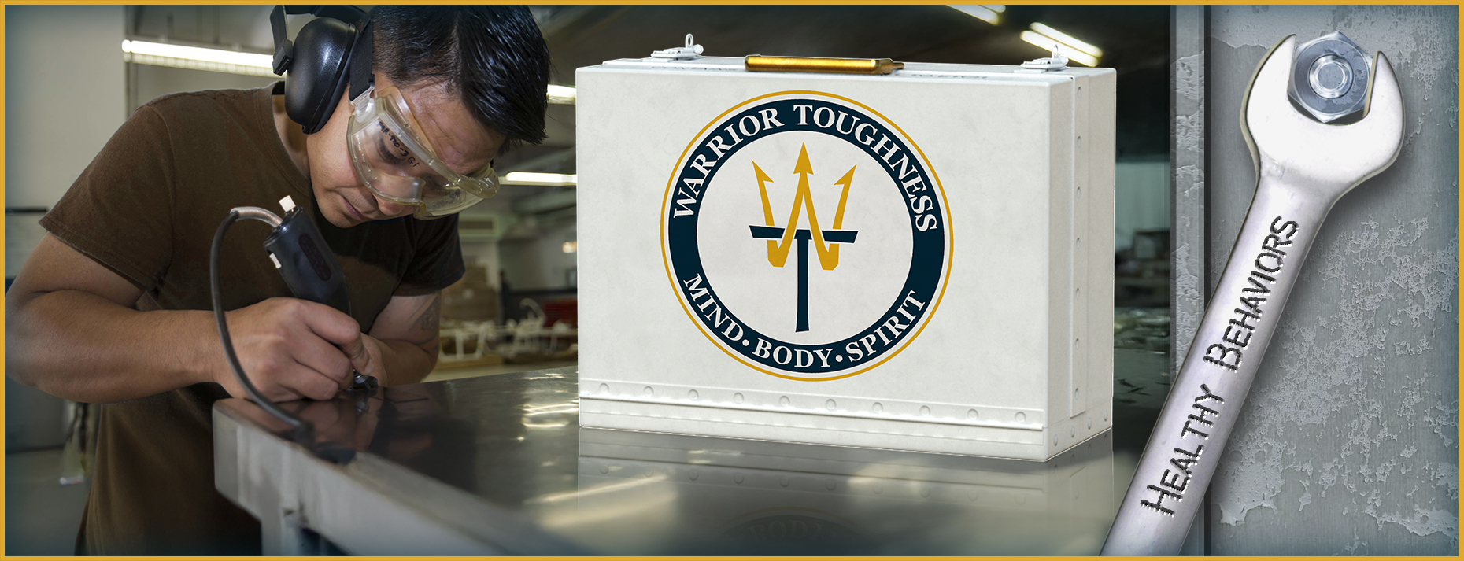
Warrior Toughness
What does Warrior Toughness mean to you?
Notes:
Facilitator Actions:
Display slide.
Discuss how graphic relates to topic.
Monitor the discussions of the Sailors.
Facilitator Content:
Discuss:
What does Warrior Toughness mean to you?
Inform:
Warrior Toughness definition:
To take a hit and keep fighting
To perform under pressure
To excel in the day in and day out grind
Warrior Toughness is the Navy's program combining years of research and separate programs that merged into a holistic approach and set of tools that focuses on the four pillars:
Toughness
Resilience
Optimizing Performance
Mitigating Stress

Slide 5
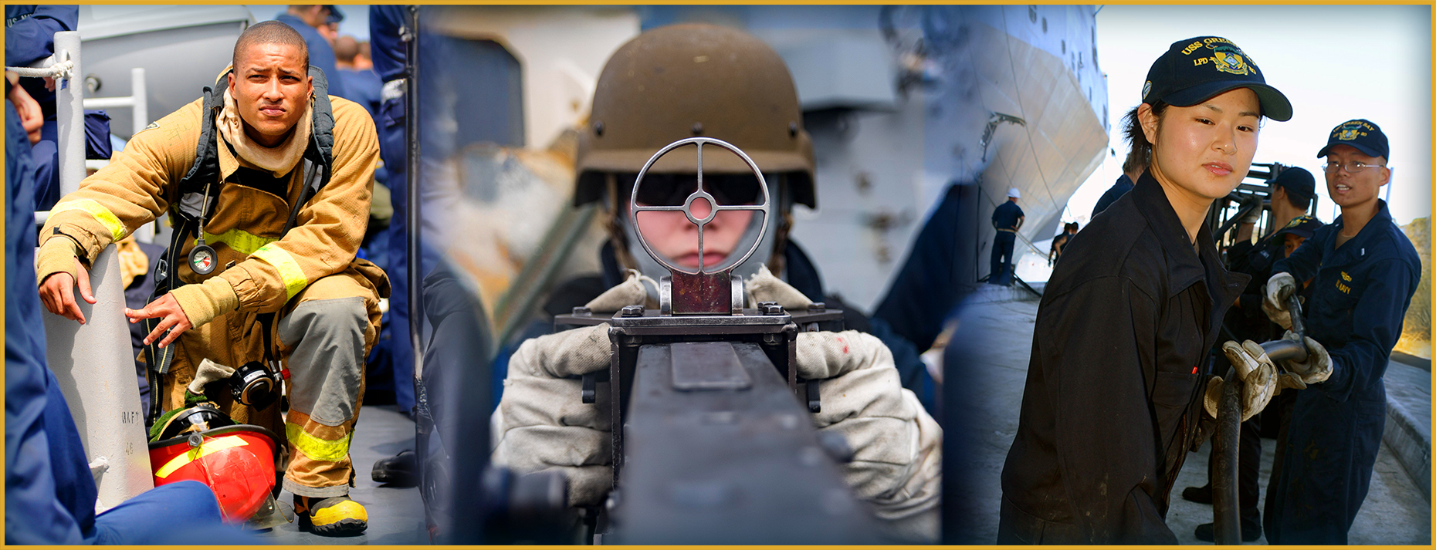
Four Pillars of Warrior Toughness
Notes:
Facilitator Actions:
Display slide.
Discuss how graphic relates to topic.
Monitor the discussions of the Sailors.
Facilitator Content:
Inform:
The four pillars strengthen the Mind, Body, and Spirit.
Toughness helps you stick to your values, make smart choices, and keep going when things get hard.
Resilience enables you to recover quickly from setbacks and maintain focus during tough situations.
Optimizing performance focuses on training that builds the skills to succeed under stress, not just rise to the occasion.
Mitigating stress involves recognizing and managing stress before it impacts performance or decision-making.

Slide 6
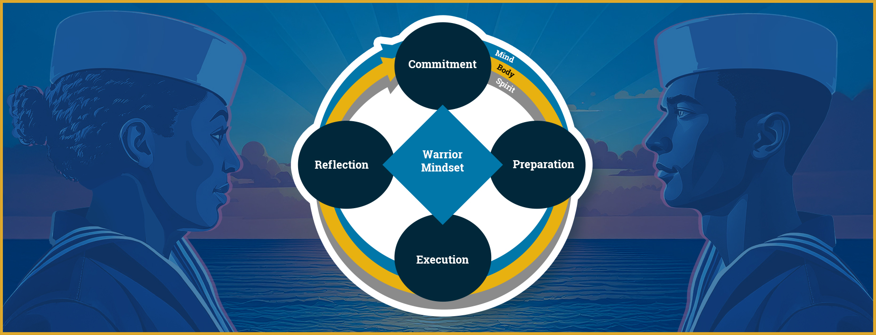
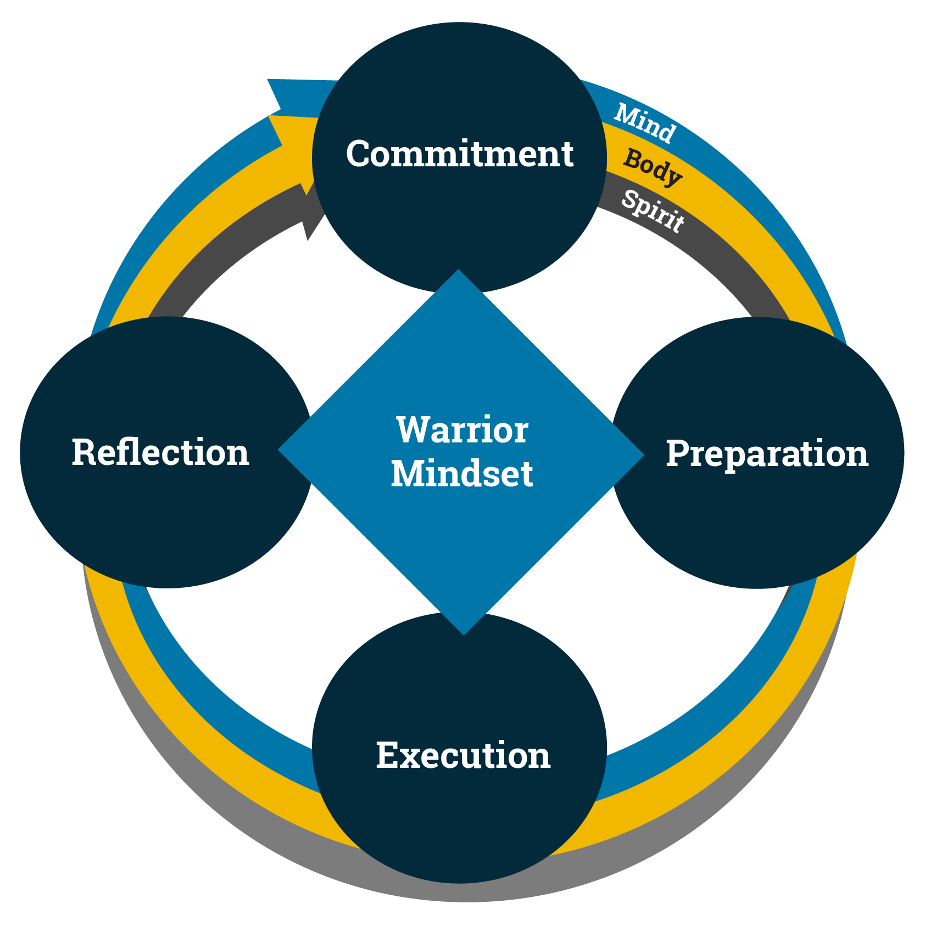
Warrior Mindset: Mind, Body, and Spirit
What are things that you do to be at peak performance?
Notes:
Facilitator Actions:
Display slide.
Discuss how graphic relates to topic.
Monitor the discussions of the Sailors.
Facilitator Content:
Inform:
The goal of Warrior Toughness is to enable the Warrior Mindset:
Knowing what we are committed to
Preparing for the event or mission
Executing at peak performance
Reflecting on what went right and areas of opportunity
The Warrior Mindset can only be effective if each domain includes the building and maintenance of our Mind, Body, and Spirit.
Sharpen your Mind by strengthening it through mindfulness exercises. Sharpen the team by practicing peer-to-peer support.
Improve your Body by using the Navy Operational Fitness and Fueling System (NOFFS) to engage in physical fitness, proper nutrition, and sleep hygiene. Improve your team by engaging in healthy behaviors and promoting intentional recovery.
Develop your Spirit by knowing your why and being aware of how your personal values tie to the organizational values. Develop your team by practicing living life in accordance with values and modeling ethical behavior.
Discuss:
Lead a 3-minute discussion:
Why do you think it is important to look at the Mind, Body, and Spirit as we move through the Warrior Mindset?
What are things that you do to be at peak performance?
Is it possible to ignore one (Mind, Body, Spirit) and still be successful?
Inform:
We all have different approaches to developing our Mind, Body, and Spirit, but it is critical that we don't ignore any of them.
Think of a three-legged stool. What happens if you remove one of the legs? (Lacks stability)
If you lack stability, what does that do to the Warrior Mindset as a person? As a team? As a leader?

Slide 7
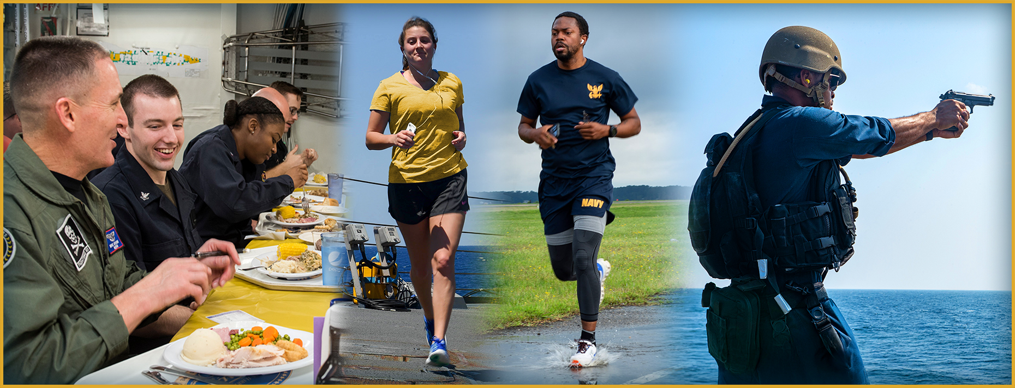
Healthy Behaviors
What are healthy behaviors?
Notes:
Facilitator Actions:
Display slide.
Discuss how graphic relates to topic.
Monitor the discussions of the Sailors.
Facilitator Content:
Discuss:
What are healthy behaviors?
How do your daily choices affect your Warrior Toughness?
Inform:
Developing your Mind, Body, and Spirit means treating yourself as a high-performing asset primed for peak performance, which makes healthy behaviors a part of the Warrior Mindset.
The key to maintaining that high-performance edge lies in the daily behaviors that keep you fueled, focused, and ready for any challenge.
Healthy behaviors are the actions you take consistently, big or small, that either strengthen or weaken your Warrior Toughness.
Healthy behaviors affect how well you think, move, recover, and lead both on and off duty.
Healthy behaviors will build a foundation for long-term success and well-being, especially in demanding environments.

Slide 8

Fuel the Body
How do you fuel your Body?
Notes:
Facilitator Actions:
Display slide.
Discuss how graphic relates to topic.
Monitor the discussions of the Sailors.
Facilitator Content:
Discuss:
How do you fuel your Body?
Inform:
Think of food as nourishment, not just calories. Healthy habits matter more than any one food or nutrient.
Focus on these five key nutrition habits:
Eat Clean. Choose natural, less-processed foods, eat fruits or vegetables with each meal, and choose animal proteins with fewer legs (e.g., chicken over pig) for higher quality protein.
Eat Often. Jumpstart your metabolism by eating breakfast within 30 minutes of waking up and eat small meals every few hours to keep energy steady
Hydrate. Drink at least 1/2 your body weight in ounces each day and make water your main source of hydration.
Recover. Repair your Body by sleeping at least 8 hours per day (e.g., power naps) and eat a mix of carbs and protein after workouts to refuel and rebuild.
Adjust your Warrior Mindset. Build lasting habits, not strict diets. Aim for balance; eat well 80% of the time and enjoy treats 20%.
Making healthy dietary choices will provide you with adequate energy for your Body.

Slide 9
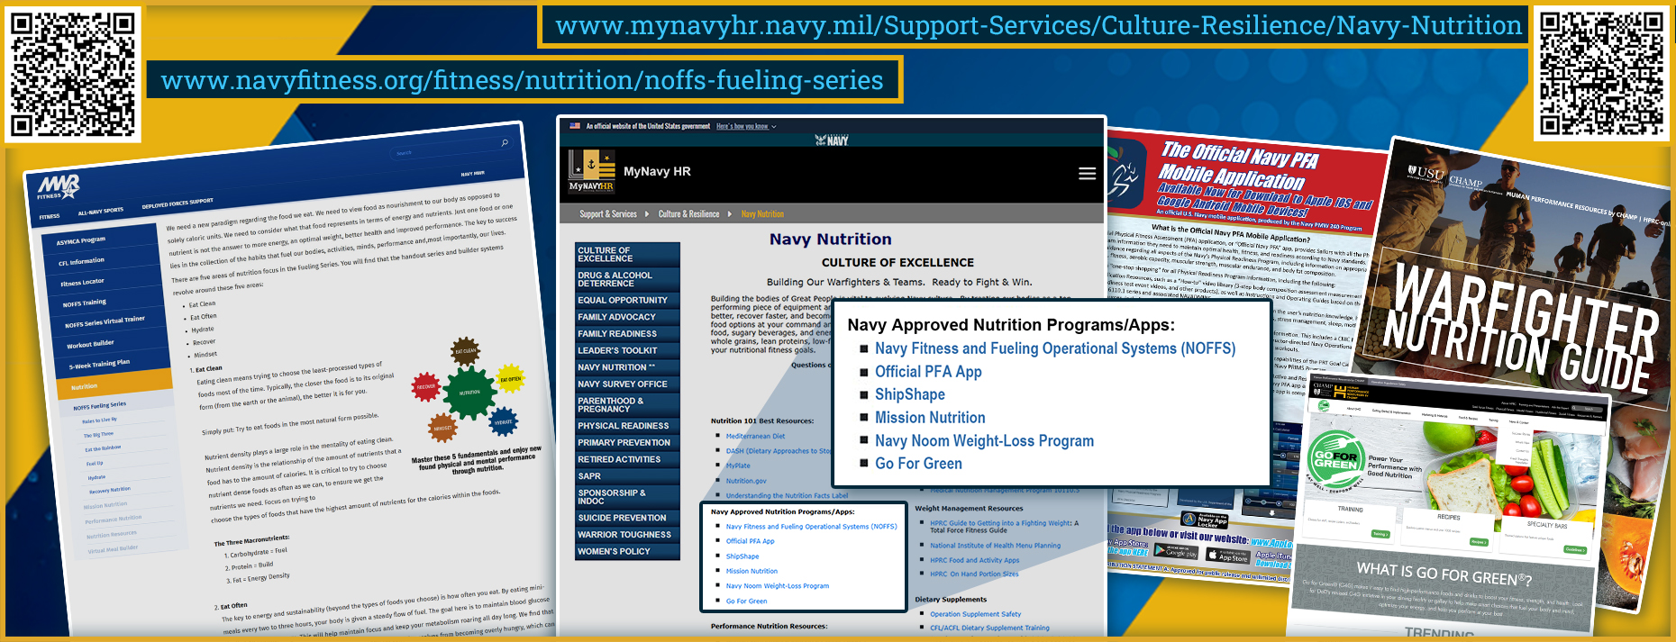
Fueling Resources
https://www.mynavyhr.navy.mil/Support-Services/Culture-Resilience/Navy-Nutrition/
https://www.navyfitness.org/fitness/nutrition/noffs-fueling-series
Navy Approved Nutrition Programs/Apps:
Navy Fitness and Fueling Operations Systems (NOFFS)
Official PFA App
ShipShape
Mission Nutrition
Navy Noom Weight-Loss Program
Go For Green
Notes:
Facilitator Actions:
Display slide.
Discuss how graphic relates to topic.
Monitor the discussions of the Sailors.
Facilitator Content:
Inform:
MyNavyHR has many free, Navy-approved nutrition resources, including applications (apps) that you can download onto your phone to assist you with meal planning and tracking your nutrition intake.
Mission Nutrition
Go For Green
NOFFS gives guidance on eating right to fuel the body and recover well.
The NOFFS Fueling Series provides practical nutrition strategies to help you eat well, stay energized, and perform at your best.
The NOFFS Virtual Meal Builder is a simple guide that shows what and how much to eat so you can fuel your body and support your health goals.
To learn more about the Navy’s free nutrition resources, you can scan the QR codes to navigate to the Navy Nutrition site. If you are unable to access the Navy Nutrition site from the QR codes, go to mynavyhr.navy.mil and navigate to Total Sailor Fit to Fight, Navy Nutrition.
Reference:
https://www.hprc-online.org/nutrition/go-green
https://www.mynavyhr.navy.mil/Support-Services/Culture-Resilience/Navy-Nutrition/
https://www.navyfitness.org/fitness/nutrition/noffs-fueling-series
https://www.navyfitness.org/fitness/nutrition/mission-nutrition
https://www.navyfitness.org/fitness/nutrition/virtual-meal-builder

Slide 10
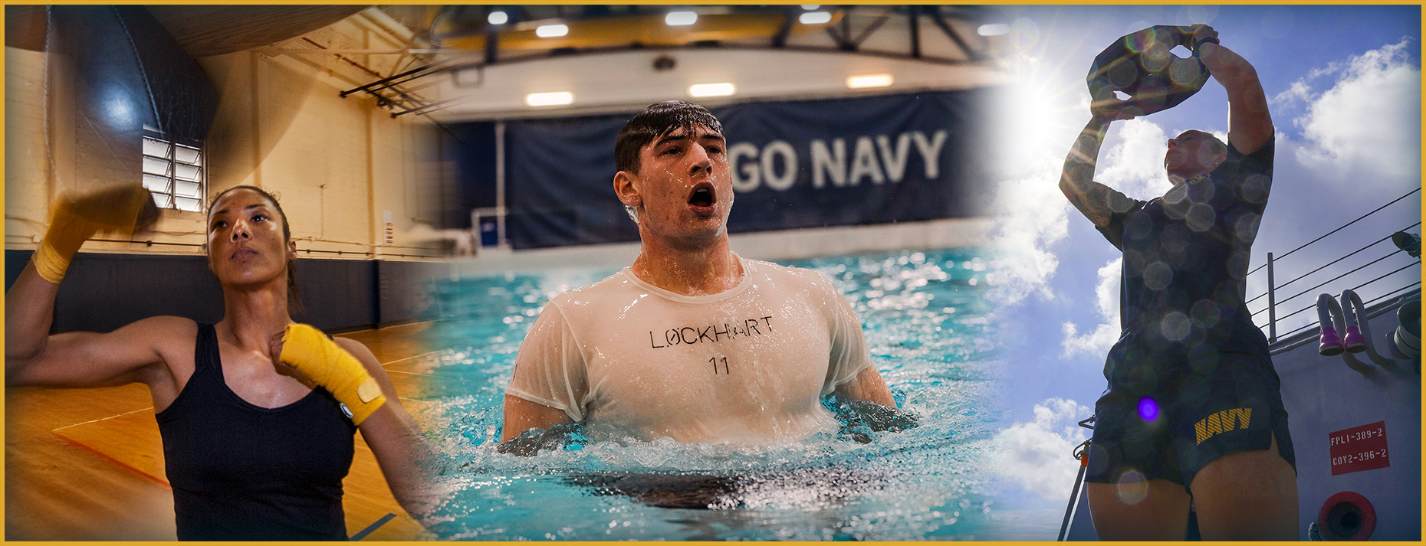
Plyo-SAQ
How might training with Plyo-SAQ help mitigate injury?
Notes:
Facilitator Actions:
Display slide.
Discuss how graphic relates to topic.
Monitor the discussions of the Sailors.
Facilitator Content:
Inform:
Plyometrics definition: “Quick and relatively explosive movements that involve a rapid eccentric action followed by a concentric action, known as the stretch-shortening cycle.”
Plyometrics-Speed, Agility, and Quickness (Plyo-SAQ) combines plyometrics (e.g., throwing), with speed (e.g., sprinting), agility (e.g., changing direction), and quickness in response to cues (e.g., auditory).
Plyo-SAQ supports injury prevention and physical readiness. This matters to every Sailor.
Injuries hurt the mission and your team.
Staying fit keeps you in the fight, not on medical hold.
Fewer injuries mean less strain on your shipmates.
Good fitness helps you stay healthy and in the Navy longer.
Being ready now means faster recovery and better performance later.
Discuss:
How might training with Plyo-SAQ help mitigate injury?
Inform:
Physical injuries during training or exercises are most frequently caused during the process of over-lengthening muscles or ligaments when landing, stopping, or decelerating. Plyo-SAQ exercises train your motor responses for sudden starts, stops, and direction changes.

Slide 11
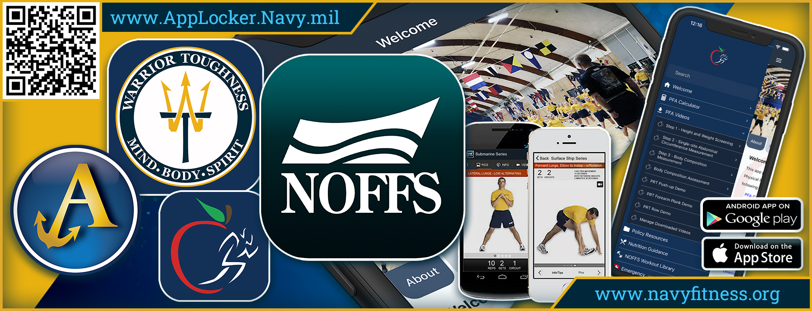
Fitness Resources
www.AppLocker.Navy.mil
www.navyfitness.org
Notes:
Facilitator Actions:
Display slide.
Discuss how graphic relates to topic.
Monitor the discussions of the Sailors.
Facilitator Content:
Inform:
NOFFS is an integrated, evidence-based physical training program designed for Sailors to:
Build job-ready fitness. NOFFS helps you train for real-world tasks, not just the Physical Readiness Test (PRT).
Prevent injuries. It teaches safe, effective movements to reduce the risk of getting hurt.
Improve strength and stamina. The program boosts physical performance for daily Navy operations.
Find easy-to-follow NOFFS workout plans at navyfitness.org or download the app from Google Play or the App Store.
NOFFS also offers many physical training series, including an endurance training series, sandbag series, and aquatics series. To learn more about upcoming training series, email navymwrfitness@navy.mil.
The Navy’s official Physical Fitness Assessment (PFA) app provides you with access to all of the Navy’s Physical Readiness Program information, including nutrition resources, command Physical Training (PT), and Fitness Enhancement Program (FEP) information.
To learn more about PFA, you can go to mynavyhr.navy.mil and navigate to Total Sailor Fit to Fight, Navy Nutrition, Navy Approved Nutrition Programs/Apps. You can also download the app from the Navy App Locker at AppLocker.Navy.mil, Google Play, or the App Store.
The Warrior Toughness app provides sports-science-based exercises, interactive worksheets, and progress tracking tools. Find it on the Navy App Locker, Google Play, or the App Store.
Reference:
https://www.mynavyhr.navy.mil
https://www.mynavyhr.navy.mil/Portals/55/Support/Culture%20Resilience/NavyNutrition/NavyPFA_AppInfoSheet.pdf?ver=JJqwEtpWVTfMYZcEKT-SpQ%3d%3d
https://www.navyfitness.org/fitness/noffs-series-virtual-trainer
https://www.navyfitness.org/fitness/noffs-training
https://www.navyfitness.org/fitness/noffs-training/noffs-series/operational-series/downloads
navymwrfitness@navy.mil
www.AppLocker.Navy.mil

Slide 12
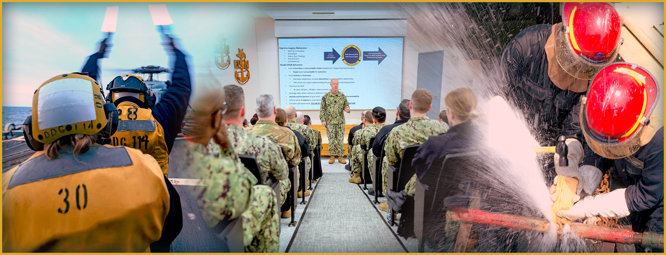
Mental Toughness
Why is it important for Sailors to keep their Minds sharp?
Notes:
Facilitator Actions:
Display slide.
Discuss how graphic relates to topic.
Monitor the discussions of the Sailors.
Facilitator Content:
Inform:
Warfighters don’t just train their Bodies; they also continually strengthen their Minds.
When solving problems and handling unexpected or challenging situations, the Mind needs a clear and intentional approach.
Sharpen your Mind by developing habits such as regular reading, engaging with thought-provoking podcasts and media, practicing mindfulness, and consistent journaling.
Strengthen your Mind and connect ideas to real missions.
The Chief of Naval Operations (CNO) Professional Reading Library is a list of books about military history, leadership, ethics, technology, and global affairs.
The Early Bird Brief (EBB) is a free daily newsletter of important military stories. Listen online or subscribe via email.
Learn how to keep your Mind focused on the present moment.
Mindfulness Coach app is a free, self-guided mindfulness training program designed for Sailors. You can download the app for iOS or Android phones by visiting the U.S. Department of Veterans Affairs (VA) Mobile at mobile.va.gov, VA App Store, Mindfulness Coach.
Chill Drills is a mobile app by Military OneSource that provides free, guided mindfulness exercises. You can download the app via Google Play or the App Store.
Discuss:
Why is it important for Sailors to keep their Minds sharp?
How does mental readiness impact mission success and decision-making under pressure?
Reference:
https://mobile.va.gov/app/mindfulness-coach
https://www.defensenews.com/ebb/
https://www.militaryonesource.mil/resources/mobile-apps/de-stress-and-relax-with-chill-drills-by-military-onesource/MyNavyHR: https://www.mynavyhr.navy.mil
https://www.navy.mil/Leadership/Chief-of-Naval-Operations/Chief-of-Naval-Operations-Professional-Reading-Library-v2/

Slide 13
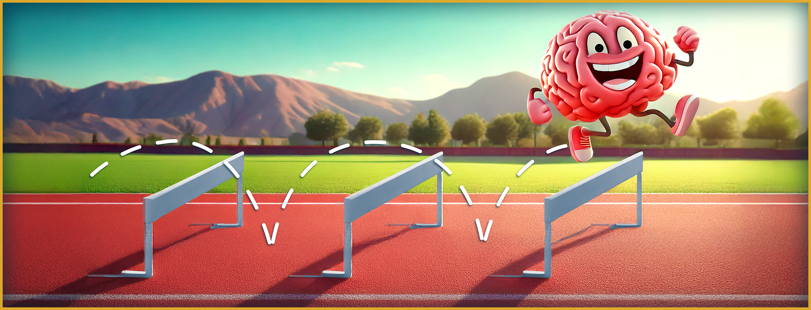
Enhancing Warrior Toughness
How does training and education enhance Warrior Toughness?
Notes:
Facilitator Actions:
Display slide.
Discuss how graphic relates to topic.
Monitor the discussions of the Sailors.
Facilitator Content:
Inform:
Healthy behaviors help you develop the skills needed during and following times of stress, like training exercises or combat situations. They help you stabilize focus, reduce stress, and enhance mental and physical recovery processes.
Recharging your Mind, Body, and Spirit is a key part of healthy behaviors. Intentional recovery means purposefully choosing activities that restore physical, mental, and emotional energy.
Making healthy behaviors part of your daily routine builds and maintains your Warrior Toughness.
By building a strong foundation of healthy behaviors, you're better prepared to get the most out of your training and education, which is key to developing Warrior Toughness.
Discuss:
How does training and education enhance Warrior Toughness?
Inform:
Training and education do more than teach tasks. They build character, sharpen mission focus, and prepare you to lead with strength and resilience under pressure.
Technical training builds confidence and reduces stress by preparing you to perform under pressure.
Classroom training strengthens your mental focus and purpose through values-based learning.
On-the-job training develops your resilience and teamwork through real-world challenges.
Learning teams foster your emotional growth and trust by learning openly from experience.

Slide 14
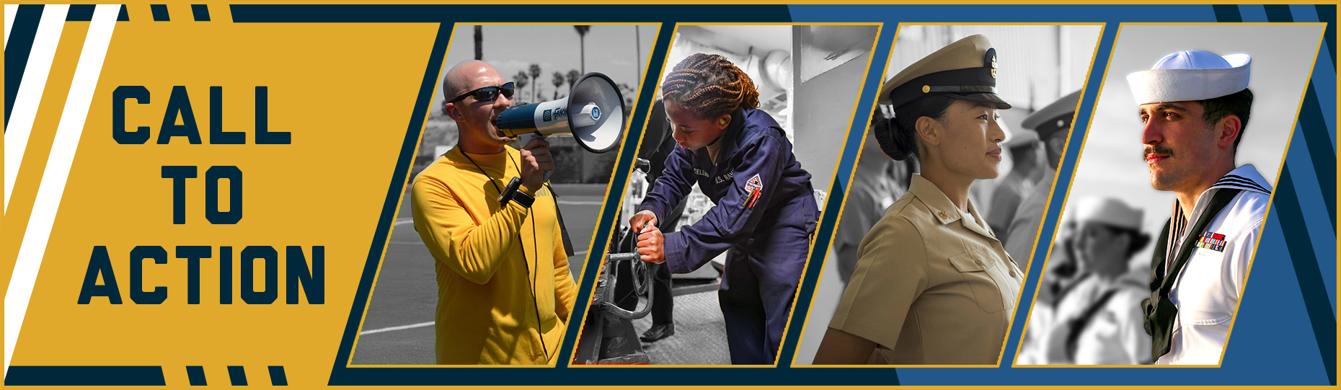
Call to Action
Be empathetic! Help your buddy get back to the fight!
Notes:
Facilitator Actions:
Display slide.
Review topics discussed and ask if there are any questions.
Check Sailor comprehension by providing review questions and/or problems.
Discuss how the call to action supports and encourages Sailors’ post training.
Relate call to action to Warrior Toughness.
Facilitator Content: N/A

Slide 15
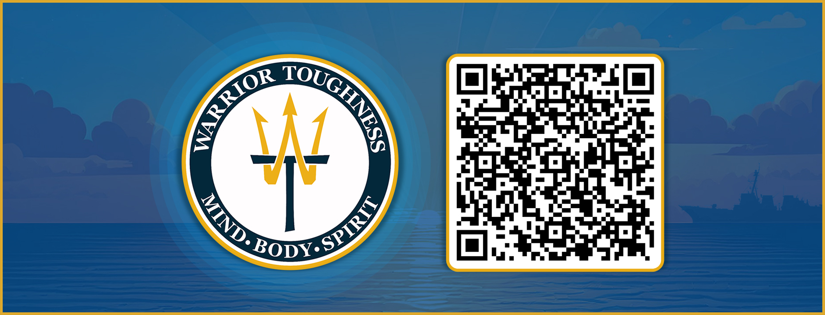
Warrior Toughness QR Code
Notes:
Facilitator Actions:
Display slide.
Facilitator Content:
Inform:
Identify Warrior Toughness QR code.

Slide 16
References
Tools and Resources
U.S. Department of Veterans Affairs, (Download) Mindfulness Coach App
Defense News, Early Bird Brief
Human Performance Resources by Champ, Go for Green: Power Your Performance with Good Nutrition
Military OneSource, Chill Drills App
MyNavy HR, (Download) Physical Fitness Assessment (PFA) App
MyNavy HR, Navy Nutrition
Notes:
Facilitator Actions:
Display slide.
Facilitator Content:
Inform:
Identify tools.
Identify resources.

Slide 17
References (continued)
Tools and Resources
Navy MWR, Navy Operational Fitness and Fueling System (NOFFS) Project
Navy MWR, Mission Nutrition
Navy MWR, Fueling Series
Navy MWR, Virtual Meal Builder
Chief of Naval Operations Professional Reading Program (PDF)
Email: navymwrfitness@navy.mil
Warrior Toughness Placemat
Navy App Locker
Notes:
Facilitator Actions:
Display slide.
Facilitator Content:
Inform:
Identify tools.
Identify resources.

Slide 18
Glossary
Glossary
Abbreviation/ Acronym | Term
app | Application
CNO | Chief of Naval Operations
EBB | Early Bird Brief
FEP | Fitness Enhancement Program
NOFFS | Navy Operational Fitness and Fueling System
PFA | Physical Fitness Assessment
Plyo-SAQ | Plyometrics-Speed, Agility, and Quickness
PRT | Physical Readiness Test
PT | Physical Training
VA | Department of Veterans Affairs
WT | Warrior Toughness
Notes:
Facilitator Actions:
Display slide.
Facilitator Content: N/A

